Slide 1
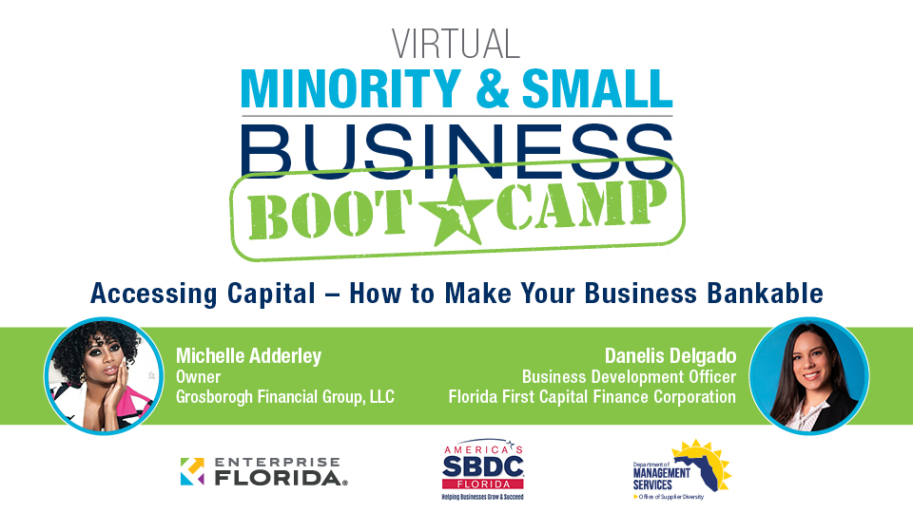

Slide 3
2021 Sustain the Pivot
Virtual Small Business Resiliency Conference
Registration for this event is separate from the Bootcamp Series and capacity is limited!
Tuesday, May 18, 12:30-5 pm EST Wednesday, May 19, 9 am-1 pm EST
floridasbdc.org/disaster/sustainthepivot

Slide 4
BANKABLE IN 2021
MICHELLE LYNN ADDERLEY 333 SE 2ND AVE #2000
MIAMI, FL 33131

Slide 5
BANKABLE
Some may ask...
What are the 5Cs of Credit? Why it is important to me as a SMALL BUSINESS OWNER.
There is something very appealing about being your own BOSS. Most people
think it is having the freedom of waking up in the morning, walking over to the mirror, and asking for the day off.
6:00 AM
YOU---"Boss, may I have the day off?" 6:00 AM
YOU---"Yes" 6:05 AM
BANK ACCOUNT---"NO"
Understanding the 5 Components of Credit will help you evaluate the financial strength of your business.
Let's get started.....

Slide 6
ARE YOU READY?

Slide 7
CHARACTER
Character: Refers to how a person has handled past debt obligations: From the credit history and personal background, honesty and reliability of the borrower to pay credit debts is determined.
The above is a small fraction of the CHARACTER segment. Banks/Private Lenders are currently using other sources such as SOCIAL MEDIA to determine CHARACTER.
GOOGLE - LINKEDIN - FACEBOOK INSTAGRAM-TWITTER

Slide 9
COMPONENTS OF CREDIT
Consumer Reports:
https://www.annualcreditreport.com/index.action https://www.innovis.com/personal/creditReport
https://personalreports.lexisnexis.com/ http://www.chexsystems.com/
There are over 30 consumer and business databases that maintain creditworthiness or personal data on you and your business.
For more information go to: iamadderley.com

Slide 10
CREDIT SCORE
How to Improve Your Credit Score
When information is updated on a borrower’s credit report, their credit score changes and can rise or fall based on new information. Here are some ways a consumer can improve their credit score:
Pay your bills on time: Six months of on-time payments are required to see a noticeable difference in your score.
Credit Line Increase: On credit card accounts, call and inquire about a credit
increase. If your account is in good standing, you should be granted an increase in your credit limit. It is important not to spend this amount so that you
maintain a lower credit utilization rate.
Don’t close a credit card account: If you are not using a certain credit card, it is best to "ADD IT TO THE FREEZER" instead of closing the account. Depending on the age and credit limit of a card, it can hurt your credit score if you close the account. Say, for instance, you have $1,000 in debt and a $5,000 credit limit
split evenly between two cards. Your c redit utilization rate is 20%, which is good. However, closing one of the cards would put your credit utilization rate at 40%, which will negatively affect your score.

Slide 11
COMPONENTS OF CREDIT
FICO® LiquidCredit® Small Business Scoring Service℠ Score Range 0-300
SBA pull EXPERIAN CONSUMER CREDIT
The minimum score to pass the SBA’s pre-screen process is
currently 140. But most lenders set their minimum score at 160. The scoring is based upon personal and business credit history and other financial information. A strong history of business
credit with timely payments to vendors and suppliers may help boost your SBSS score.
Because businesses are not covered by FCRA protections, you can be denied business financing due to your SBSS score, and lenders are not required to notify you of the reason why.
The FICO SBSS score will be used for term loans, lines of credit, and commercial loans up to $350,000 from the Small Business
Administration (SBA). The minimum score to pass the SBA’s pre- screen process is currently 140.
Small Business Financial Exchange (SBFE)
The SBFE is a nonprofit trade association that maintains the SBFE Data Warehouse, which compiles payment data for
commercial bank loans and lines of credit, credit cards and leases and from participating lenders. Inquiries (aka “credit pulls”) will also be listed, however, Equifax does not take
inquiries into account when calculating risk scores.

Slide 12
COMPONENTS OF CREDIT
Equifax Business Credit Reports
Company data: Name, address, phone numbers, alternate business names (including DBA’s or
“doing business as” names), SIC/ NAICS codes, owner and guarantor names.
Credit data: Equifax does not take inquiries into account when calculating risk scores.
Public record data: business tax liens,
judgments, UCC filings and bankruptcies
Payment Index: “Days Beyond Terms” (DBT)
Financial Data: General information about bank balances and returned checks, assets, real
estate owned, inventory and sales, as available. Equifax ID: A unique identifying number will be assigned to the business.

Slide 13
COMPONENTS OF CREDIT
Experian Intelliscore Plus℠ Credit Score
The Intelliscore scores range from 1 to 100, the higher your score, the lower your risk class.
Conversely, the lower your score, the higher your
risk class. The chart below outlines each Intelliscore Plus credit score range and its associated meeting.
Payment History: current payment status
Frequency: payment history-liens and judgments- bankruptcies related to your business or personal accounts
Monetary: how you utilize credit
Score Range | Risk Class | Risk Description
76 – 100 | 1 | Low
51 – 75 | 2 | Low – Medium
26 – 50 | 3 | Medium
11 – 25 | 4 | High – Medium
1 – 10 | 5 | High

Slide 14
COMPONENTS OF CREDIT
DUNN & BRADSTREET PAYDEX
To determine your business’s PAYDEX score, Dun & Bradstreet gathers data from the suppliers and vendors with which you
do business over a rolling 12-month period. Each
supplier/vendor is considered a tradeline account, and the
payments you make to that supplier/vendor are considered a payment experience. According to Dun & Bradstreet, two
tradelines with at least three credit experiences are needed for a PAYDEX score;
however, from customer experience, business owners need at least three tradelines reported to create a score.
Dun & Bradstreet analyzes the promptness of your payments against the terms of sale for each payment experience. So, the
faster you pay your bills, the better your score.
Want an EXCELLENT PAYDEX SCORE?
100 Payment comes 30 days sooner than terms
Paydex Range: Paydex Risk Interpretation: 80 – 100 LOW risk of late payment
(averages prompt to 30 days within terms)
50 – 79 MEDIUM risk of late payment (averages 30 or less beyond terms)
0 – 49 HIGH risk of late payment
(averages 30 to 120 days beyond terms)

Slide 15
COMPONETS OF CREDIT
Paydex Score: Explanation:
100 Payment comes 30 days sooner than terms 90 Payment comes 20 days sooner than terms 80 Payment comes on terms
70 Payment comes 15 days beyond terms 60 Payment comes 22 days beyond terms 50 Payment comes 30 days beyond terms 40 Payment comes 60 days beyond terms 30 Payment comes 90 days beyond terms 20 Payment comes 120 days beyond terms
1 – 19 Payment comes over 120 days beyond terms
5 Companies that report to D&B
•
•
•
•
•
http://www.bpbusinesssolutions.com/ http://www.quill.com/
BBVA Compass Business Secured Visa http://advanceautoparts.com/
http://www.uline.com
Bonus
Wells Faro Business Secured MasterCard

Slide 16
CAPACITY
Capacity is the maximum level of output that a company can sustain to make a
product or provide a service. Planning for capacity requires management to accept limitations on the production process.
Depending on the business type, capacity can refer to a production process, human resources allocation, technical thresholds, or several other related concepts.
No system can operate at full capacity for a prolonged period; inefficiencies and delays make it impossible to reach a theoretical level of output over the long run.
Understanding Capacity
Capacity ties into the fact that all production operates within a relevant range. No piece of machinery or equipment can operate above the relevant range for very
long. Assume, for example, ABC Manufacturing makes jeans, and that a commercial sewing machine can operate effectively when used between 1,500 and 2,000 hours a month.

Slide 17
CAPACITY
KEY TAKEAWAYS
Capacity is the maximum output level a company can sustain to provide its products or services.
Depending on the business type, capacity can refer to a production process, human resources allocation, technical thresholds, or several other related
concepts.
Some larger or highly technical companies may hire specialized managers to manage capacity.
If the firm sees a spike in production, the machine can operate at more than 2,000 hours for a month, but the risk of a breakdown increases. Management has to plan production so that the machine can operate within a relevant range.
Capacity Level Differences
Capacity assumes a constant level of maximum output. This production level
assumes no machine or equipment breakdowns and no stoppages due to employee vacations or absences.

Slide 18
BANKABLE
Building Your Bank
Folder Content
Left Side BUSINESS FINANCIALS
2020 TAX RETURN
2019 TAX RETURN LAST 3 BANK STATEMENTS INCOME STATEMENT/P&L BUSINESS CREDIT LETTERS
REFERENCE LETTERS COVER SHEET OF YOUR ASK
Right Side PERSONAL FINANCIALS
2020 TAX RETURN
2019 TAX RETURN LAST 3 BANK STATEMENTS 3 BUREAU CREDIT REPORT
RESUME REFERENCE LETTERS
BUSINESS DOCS COVER SHEET

Slide 19
CAPITAL
Capital is a broad term that can describe anything that confers value or benefit to its owners, such as a factory and its machinery, intellectual property like patents, or the financial assets of a business or an individual. While money itself may be
construed as capital is, capital is more often associated with cash that is being put to work for productive or investment purposes.
In general, capital is a critical component of running a business from day to day
and financing its future growth. Business capital may derive from the operations of the business or be raised from debt or equity financing. When budgeting,
businesses of all kinds typically focus on three types of capital: working capital, equity capital, and debt capital. A business in the financial industry identifies
trading capital as a fourth component.

Slide 20
CAPITAL
Capital is typically cash or liquid assets being held or
obtained for expenditures. In a broader sense, the term may be expanded to include all of a company’s assets that have monetary value, such as its equipment, real estate, and
inventory. But when it comes to budgeting, capital is cash flow.
In general, capital can be a measurement of wealth and also a resource that provides for increasing wealth through direct
investment or capital project investments. Individuals hold capital and capital assets as part of their net worth.
Companies have capital structures that include debt capital, equity capital, and working capital for daily expenditures.
How individuals and companies finance their working capital and invest their obtained capital is critical for their
prosperity.

Slide 21
CAPITAL
HOW CAPITAL IS USED
Capital is used by companies to pay for the ongoing
production of goods and services in order to create profit.
Companies use their capital to invest in all kinds of things for the purpose of creating value. Labor and building expansions are two common areas of capital allocation. By investing
capital, a business or individual seeks to earn a higher return than the capital's costs.
At the national and global levels, financial capital is analyzed by economists to understand how it is influencing economic
growth. Economists watch several metrics of capital including personal income and personal consumption from the
Commerce Department’s Personal Income and Outlays
reports. Capital investment also can be found in the quarterly Gross Domestic Product report.

Slide 22
CAPITAL
Working Capital
A company's working capital is its liquid capital assets available for fulfilling daily obligations. It is calculated through the following two assessments:
Current Assets – Current Liabilities
Accounts Receivable + Inventory – Accounts Payable
Working capital measures a company's short-term liquidity. More specifically, it represents its ability to cover its debts, accounts payable, and other obligations that are due within one year.
Note that working capital is defined as current assets minus
its current liabilities. A company that has more liabilities than assets could soon run short of working capital.

Slide 23
COLLATERAL
The term collateral refers to an asset that a lender accepts as security for a loan. Collateral may take the form of real estate or other kinds of assets, depending on the purpose of the loan. The collateral acts as a form of protection for the lender. That is, if the borrower defaults on their loan payments, the lender can seize the collateral and sell it to recoup some or all of its losses.

Slide 24
COLLATERAL
KEY TAKEAWAYS
Collateral is an item of value used to secure a loan.
Collateral minimizes the risk for lenders.
If a borrower defaults on the loan, the lender can seize the collateral and sell it to recoup its losses.
Mortgages and car loans are two types of collateralized loans.
Other personal assets, such as a savings or investment account, can be used to secure a collateralized personal loan.

Slide 25
COLLATERAL
How Collateral Works
Before a lender issues you a loan, it wants to know that you have the ability to repay it. That's why many of them require some form of security. This security is called collateral which minimizes the risk for lenders. It helps to ensure that the
borrower keeps up with their financial obligation. In the
event that the borrower does default, the lender can seize the collateral and sell it, applying the money it gets to the
unpaid portion of the loan. The lender can choose to pursue legal action against the borrower to recoup any balance
remaining.
As mentioned above, collateral can take many forms. It
normally relates to the nature of the loan, so a mortgage is
collateralized by the home, while the collateral for a car loan is the vehicle in question. Other nonspecific, personal loans can be collateralized by other assets. For instance, a secured credit card may be secured by a cash deposit for the same
amount of the credit limit—$500 for a $500 credit limit.

Slide 26
COLLATERAL
Loans secured by collateral are typically available at
substantially lower interest rates than unsecured loans. A lender's claim to a borrower's collateral is called a lien—a legal right or claim against an asset to satisfy a debt. The
borrower has a compelling reason to repay the loan on time because if they default, they stand to lose their home or
other assets pledged as collateral.
Types of Collateral
The nature of the collateral is often predetermined by the loan type. When you take out a mortgage, your home
becomes the collateral. If you take out a car loan, then the car is the collateral for the loan. The types of collateral that
lenders commonly accept include cars—only if they are paid off in full—bank savings deposits, and investment accounts. Retirement accounts are not usually accepted as collateral.
You also may use future paychecks as collateral for very short-term loans, and not just from payday lenders.

Slide 27
COLLATERAL
Traditional banks offer such loans, usually for terms no
longer than a couple of weeks. These short-term loans are an option in a genuine emergency, but even then, you should
read the fine print carefully and compare rates.
Collateralized Personal Loans
Another type of borrowing is the collateralized personal loan, in which the borrower offers an item of value as security for a loan. The value of the collateral must meet or exceed the
amount being loaned. If you are considering a collateralized personal loan, your best choice for a lender is probably a
financial institution that you already do business with,
especially if your collateral is your savings account. If you
already have a relationship with the bank, that bank would be more inclined to approve the loan, and you are more apt to
get a decent rate for it.

Slide 28
COLLATERAL
IMPORTANT!:
Use a financial institution with which you already have a
relationship if you're considering a collateralized personal loan
Examples of Collateral Loans Residential Mortgages
A mortgage is a loan in which the house is the collateral. If the homeowner stops paying the mortgage for at least 120
days, the loan servicer can begin legal proceedings which can lead to the lender eventually taking possession of the house through foreclosure. Once the property is transferred to the
lender, it can be sold to repay the remaining principal on the loan.
Home Equity Loans
A home may also function as collateral on a second mortgage or home equity line of credit (HELOC).
Residential Mortgages

Slide 29
COLLATERAL
In this case, the amount of the loan will not exceed the available equity. For example, if a home is valued at
$200,000, and $125,000 remains on the primary mortgage, a second mortgage or HELOC will be available only for as much as $75,000.

Slide 30
WORK WITH ME

Slide 31
THANK YOU!
iamadderley
(All Social Media Platforms) iamadd^{t} erley.com iamadderley@gmail.com

